Slide 1
Severe Drought in the United States
A short deck, rendered to both revealjs and PowerPoint
Thomas Reinke

Slide 2
The data
The U.S. Drought Monitor dataset:
325,728 rows: state, week, and severity level
1044 weeks, July 2001 to July 2021
52 states and territories
Severity D0 (dry) to D4 (exceptional drought)
Source: TidyTuesday, week of 2021-07-20.
Notes:
State severity shares sum to 100%. D2+ is the sum of levels D2, D3, and D4.

Slide 3
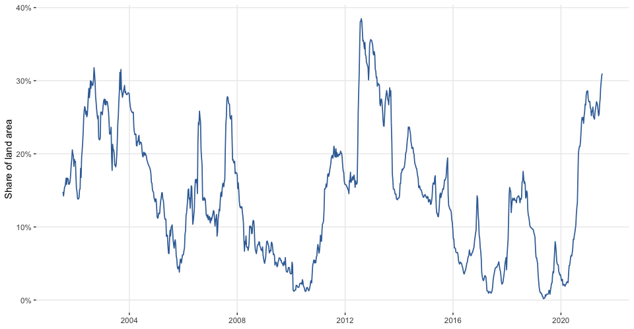
National time series
Notes:
Drought episodes: West in early 2000s, trough in 2010, peak in 2012, increase in 2020. In revealjs, zoom the interactive chart to specific years during questions.

Slide 4
Peak drought week
Week of August 7, 2012
38.5% of national land area in D2 to D4 drought
Colorado, Kansas, Missouri, and Nebraska reached peak levels
Notes:
Pause here before displaying the map.

Slide 5
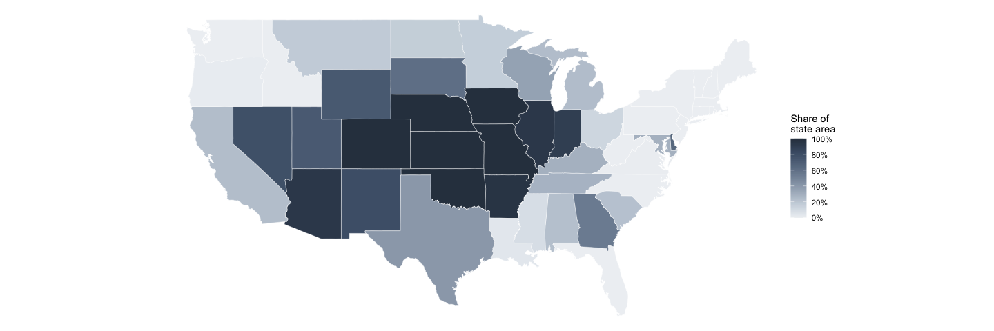
Peak drought map

Slide 6
Static snapshot of peak week. The revealjs deck animates this map over time.
Notes:
In revealjs, select quarters to show other drought episodes.

Slide 7
Top affected states
State | Average D2+ | Peak D2+ | Week of peak
NV | 37.6% | 100% | Jul 2007
AZ | 37.1% | 100% | Jun 2002
NM | 33.9% | 100% | Dec 2003
UT | 30.9% | 100% | Mar 2003
CA | 30.4% | 100% | May 2014
WY | 29.2% | 100% | Sep 2002

Slide 8
Slide tables use six rows to fit screen frames. This table uses knitr::kable() to export as an editable PowerPoint table.
Notes:
The full table appears in the report.

